Slide 1
Predictive analysis on consumer reviews in automobile industry based on linguistic algorithms
PROJECT GUIDE
Dr.Lilly Raamesh
MEMBERS
Shriram B.(312313205100)
Tanay Pardeshi(312313205115)

Slide 2
OBJECTIVE
The main aim of this project is to analyze consumer reviews for automobile industries and predict the flaws or areas of improvement in the various sectors of the industry. This is done with the help of the Natural Language Processing library (NLP) in Python that helps in dividing a sentence into positive, negative or neutral feedback based on the polarity of the sentence. This analysis can be further used in correlating the data to vehicular emissions of various automobile manufacturers and hence enabling them to identify the areas that require improvement and take corresponding measures to reduce emissions and address the issues of climate change.

Slide 3
ABSTRACT
The system proposes a domain independent supervised learning methodology that uses machine learning techniques to build models or discriminators for the different classes such as positive or negative reviews using a large corpus for an automobile organization in order to increase the overall productivity. The training data consists of a set of training examples of the product reviews of automobiles that is segregated based on various models and years of manufacturing.
This training dataset is fed into the system which analyzes commonly occurring data patterns and identifies the polarity of each review provided by the user. The analyzed data is then used to predict the nature of possible outcomes from previous data and provide recommendations to improve efficiency and assist in examining the effects of vehicular emissions on climate change.

Slide 4
LITERATURE SURVEY

Slide 5
S.NO | TITLE/AUTHOR/YEAR | METHODOLOGY | MERITS | DEMERITS
1. 2. | Sentiment Analysis in Social Networks: A Study on Vehicles Author : Renata Maria Baracho and Gabriel Silva Year : 2015 Analysis of review helpfulness based on Consumer perspective. Author : Yuanlin Chen, Yueting Chai, Yi Liu, and Yang Xu Year : 2015 | Presented a novel architecture on sentimental analysis that aims to create a process of sentiment analysis based on ontologies in the automobile domain and then to develop a prototype. Includes the exploration of the applications of reviews based on consumer perspective. | The presented architecture enabled applying the ontologies across various other domains . | The applied methodology has been restricted to the scope of certain products inspite of the ability to make it a much more generalized approach. Empirically Analyzed data uses single data source . Absense of quantitative calculation model of helpfulness with these factors.

Slide 6
S.NO | TITLE/AUTHOR/YEAR | METHODOLOGY | MERITS | DEMERITS
3. 4. | Co-Extracting Opinion Targets and Opinion Words from Online Reviews Based on the Word Alignment Model. Author : Kang Liu, Liheng Xu, and Jun Zhao Year : 2015 Social Media Sentimental Analysis with Sarcasm Detection Author : Edwin Lunando and Ayu Purwarianti Year : 2014 | Proposes a novel approach based on the partially supervised alignment model, which regards identifying opinion relations as an alignment process. Concentrates on identifying key aspects of natural language that cannot be normally identified by polarized lexicons such as sarcasm. | The proposed Word Alignment Model (WAM) precisely mines the opinion relations among words. The usage of negativity information and the number of interjection words increases sarcasm detection rate. | Usage of standard word alignment models are often trained in a completely unsupervised manner, which results in alignment quality that may be unsatisfactory Implications of SentiWordNet and other such external libraries may affect the ability to detect certain nuances of speech or sarcasm.

Slide 7
S.NO | TITLE/AUTHOR/YEAR | METHODOLOGY | MERITS | DEMERITS
5. 6. | Mining Online User-Generated Content: Using Sentiment Analysis Technique to Study Industrial Service Quality. Author : Wenjing Duan, Qing Cao, Yang Yu and Stuart Levy Year : 2015 Research on Brand Equity of Automobile Industry - Based on Customer Experience and Modern Service Author : X Zhang , Guoqin Bu , Shuzen Wu Year : 2013 | Uses the sentiment analysis technique to decompose user reviews into five dimensions to measure industrial service quality. Use customer experience as a breakthrough point and key factors, using empirical analysis of the data collection, applying calculating statistics method to analyze customer's satisfaction index from multi-dimensions. | The division of reviews enables much deeper understanding towards parameters of importance in service quality. There is an increased emphasis on the fact that more attention should be paid to the modern automobile comprehensive service level, which is mainly based on customer experience. | The generalization of reviews is anchored towards particular sectors and not in context with other industries. The evaluation of the automobile industry in the analysis is quite specific towards the context of China and is not generalized for other nations.

Slide 8
PROPOSED SYSTEM MERITS
These are the various advantages of our proposed system :
Usage of Supervised Learning in place of conventional domain specific lexicon approaches.
Providing a comparison of automobiles based on vehicular emissions and performance to identify defaulters.
Identification of sarcastic reviews with better efficiency.

Slide 9
SYSTEM ARCHITECTURE

Slide 11
MODULES

Slide 12
Data Collection and Cleansing
In order to create the training data set we use a RESTful (Representational State Transfer) API for accessing the dataset. RESTful web services are built to work best on the Web. The dataset is obtained by requesting the RESTful service called Edmunds Data API, obtaining a response and then storing the response in a JSON File.
The dataset consists of a large number of vehicle makes and of different models and categories. The dataset has to be cleansed in order to match the parameters such as Engine Type, BS4/BS3 Standards etc. The collected dataset can be stored as standard files or can be converted to DataFrames using libraries such as Python Pandas.

Slide 13
Importing Data into RDDs in Spark
Resilient Distributed Datasets (RDD) is a fundamental data structure of Spark. It is an immutable distributed collection of objects. Each dataset in RDD is divided into logical partitions, which may be computed on different nodes of the cluster. RDDs can contain any type of Python, Java, or Scala objects, including user-defined classes.
PySpark – A downport to Spark’s Scala API is quite efficient in handling large datasets. The dataset is imported as DataFrames into the RDD and is available for further processing.

Slide 14
SCREENSHOTS

Slide 19
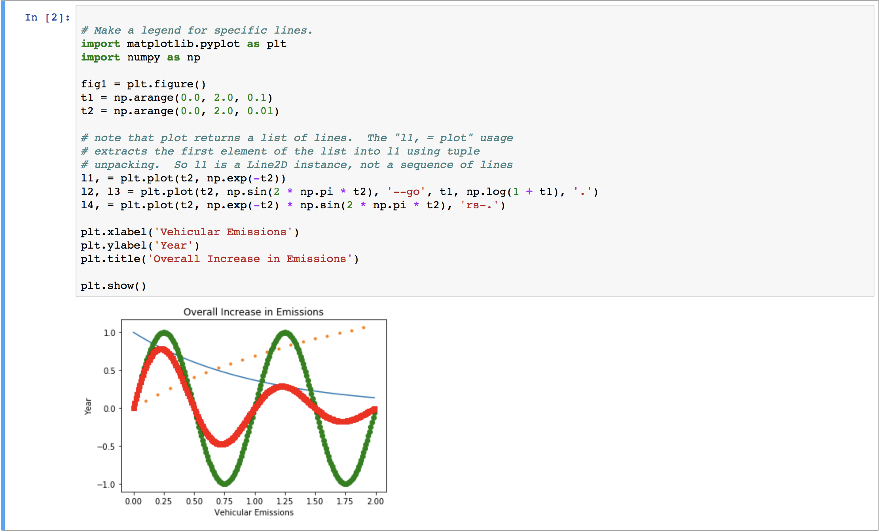

Slide 20
FUTURE ENHANCEMENTS
To allow potential automobile manufacturers to build car makes considering effects of vehicular emissions on climate change.
Set a benchmark for the manufacturers to enhance performance of various car parts based on consumer reviews.
Automobiles of different brands can be compared based on various factors to help buyers to choose the best car brand based on their usage.

Slide 21


